Slide 1
Cloud based Online Blood Banking system
Student Name- Harshit Dutt Tyagi
Mentor Name- Dr. Prakash Srivastava

Slide 2
INTRODUCTION
The main aim of this project is to save lives of people by providing blood.
My project Online Blood Banking System Website.
This website reduces the time to a greater extent that is searching and requesting for the required blood.
Thus this website provides the required information in less time and also helps in quicker decision making and managing availability of blood.

Slide 3
PROBLEM STATEMENT
The major problem in Blood Donation systems was that, they don’t follow the actual needs of users.
Traditional blood donation systems were developed by 1 or 2 perspective.
There was shortage and sometimes unavailability of rare blood groups due to less modules i.e. patient and donors in Hospitals.

Slide 4
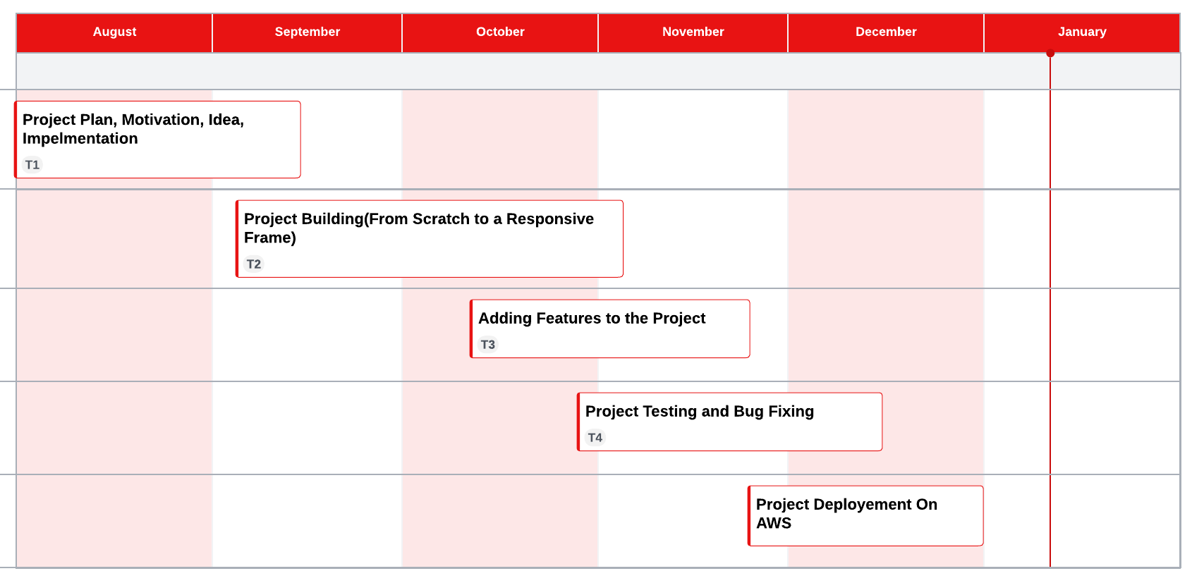
PROJECT MANAGEMENT(GANTT CHART)

Slide 5
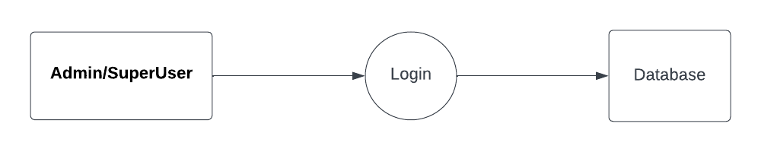
METHODOLOGY

Slide 6
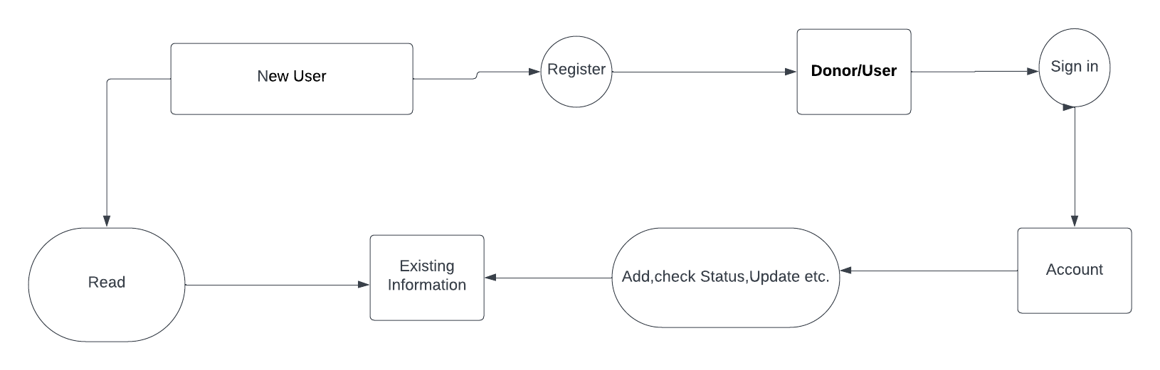
METHODOLOGY

Slide 7

METHODOLOGY

Slide 8
Features of the Cloud-Based Online Blood Banking System
Logins for users/Hospitals,
New donor can be added,
Donor can request easily with his account,
List of the donors and available blood can be easily available from data search,
You can add yourself as donor or as a hospital,
Realtime data update,
Security for authenticated user.

Slide 9

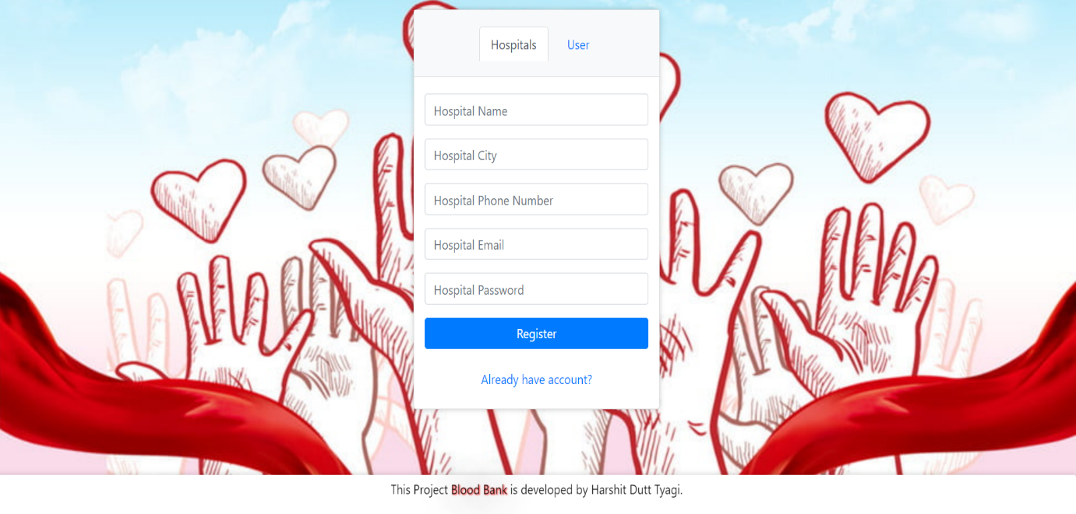
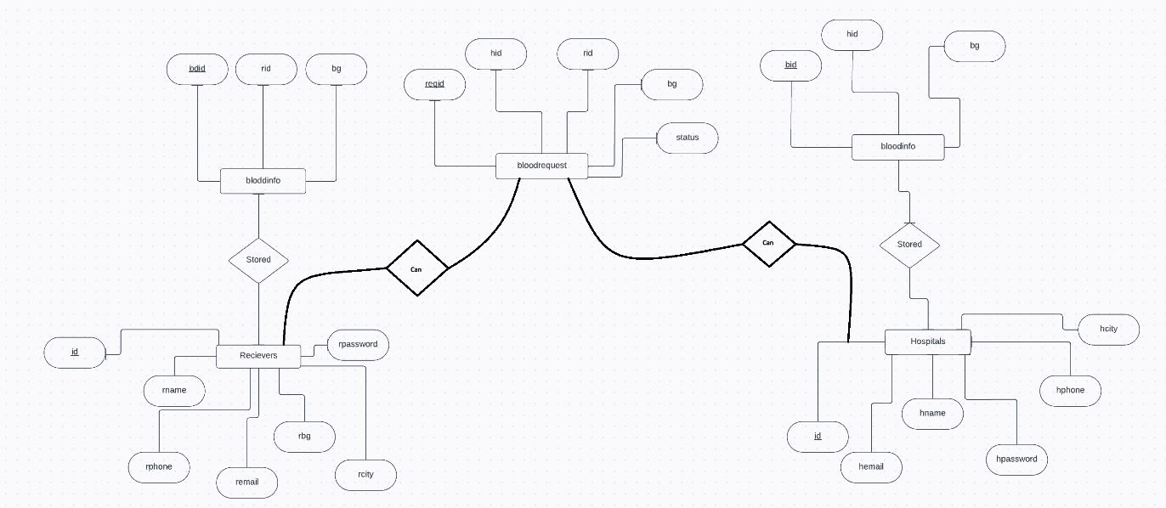
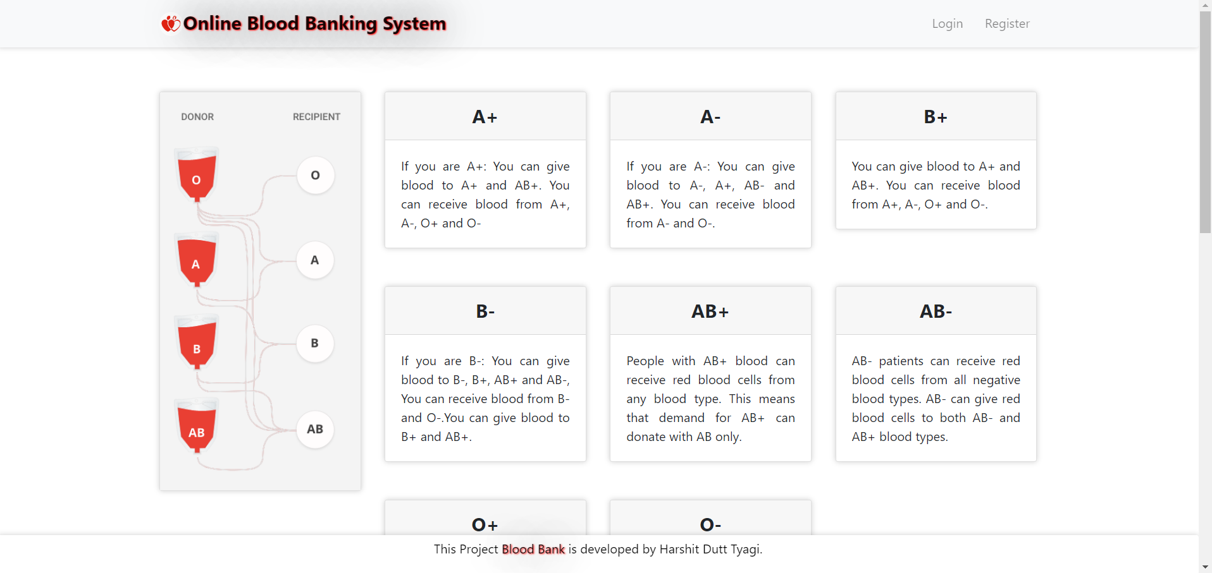
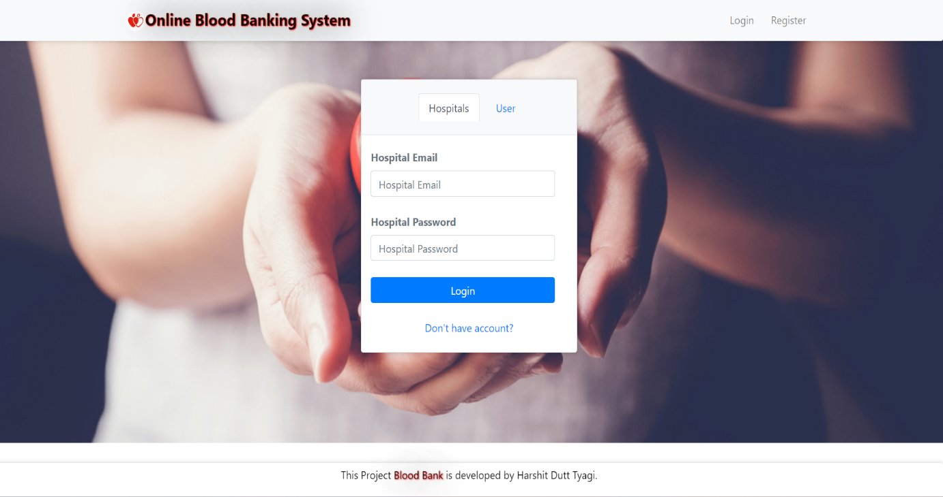
RESULT AND DISCUSSION

Slide 10
FUTURE WORK
I will try to implement a machine learning model in this project to classify all the blood groups available with hospitals.
Also I will try to integrate GIS system in it for the location of Hospital and Donor
Mobilink broadcasts the request to subscribers' pagers, displaying vital information like blood group, hospital, and contact details for quick donor response.
Can give rewards on blood donation by collaborating with blood banks to users.

Slide 11
THANK YOU

